Slide 1


JOB'S HORIZON
"Connecting Talents with Opportunities"
Welcome to JOB'S HORIZON, a platform designed to seamlessly connect talented individuals with the right job opportunities. We aim to revolutionize the recruitment process, making it efficient and user-friendly for everyone involved.
by Sahil Kumar

Slide 2
AGENDA
Introduction to JOB'S HORIZON
Advantages of JOB'S HORIZON
Aim and Objectives
Data Flow Diagram
Drawback of Existing System
Project Explanation
Technologies Used
Modules Overview
Conclusion and Future Scope
Admin Pannel Features
Thank you
Job Seeker Pannel Features
Company Pannel Features

Slide 3

Introduction to JOB'S HORIZON
Project Overview , Importance and Objective
Project Overview : Aim to revolutionize the job market by creating a platform that enhance the matching between job seekers and employers.
Importance of Job's Horizon: In an increasing digital economy , efficient job matching is critical for reducing the unemployment rate. This project addresses prevalent gap in existing platforms.
Objective of the presentation: To provide a comprehensive understanding of Job's Horizon and how it’s different from the traditional job market.

Slide 4

Aim and Objectives
1
Streamline Job Search
2
Bridge the Gap
Simplify the job search and recruitment process, reducing time and effort.
Effectively connect job seekers and employers, creating perfect matches.
3
User-Friendly Platform
Provide an intuitive platform for all stakeholders, ensuring a positive experience.

Slide 5
Drawbacks of Existing Systems
Limited Search
Lack of Personalization
Inefficient Tracking
Poor User Experience
Current systems often have restricted search capabilities.
Missing tailored experiences for users.
Application tracking is often cumbersome.
Job seekers and employers both face usability issues.

Slide 6

Project Overview
Web-Based Solution
Three Main Modules
JOB'S HORIZON is a comprehensive web-based job portal.
Includes Admin, Job Seeker, and Company panels.
Key Features
Offers extensive functionalities for efficient job management.

Slide 7




Admin Panel
User Management
Job Approval
Analytics
Oversee and manage all user accounts.
Approve and moderate job postings.
Generate reports on platform usage.

Slide 8





Job Seeker Panel
Profile Management
Create and update personal profiles.
Advanced Search
Utilize sophisticated search filters.
Application Tracking
Monitor application statuses.
Resume Builder
Tools to create professional resumes.

Slide 9

Company Panel
1
Profile Management
Manage company profiles and branding.
2
Job Posting
Post and manage job openings.
3
Applicant Screening
Screen and shortlist candidates effectively.
4
Interview Scheduling
Schedule interviews.

Slide 10
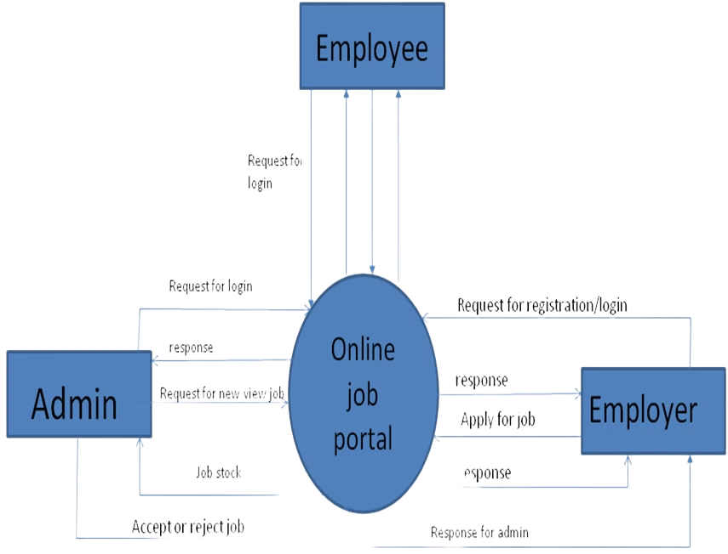
Data Flow Diagram
The Data Flow Diagram illustrates how data moves between the Admin, Job Seeker, and Company modules. It outlines key processes and data storage points, ensuring efficient and secure data management across the JOB'S HORIZON platform.
This design ensures integrity and accessibility for all users.

Slide 11

Advantages
Enhance User Experience: With a user friendly interface and personalized matching algorithm , Job's Horizon prioritizes the need of its user for better management.
Efficient Job's Matching: Leverage advanced technologies for matching, the platform connect the job's seeker with opportunities that align with their skill and interest.
Data Driven Insight: By gathering and analyzing data Job's Horizon continuously refines their platform.

Slide 12





Technologies Used
Backend
Frontend
2
Node.js, Express.js
HTML, CSS, JavaScript, React
1
Database
MongoDB
3
Deployment
Testing
5
Versel or Netlify
Jest and Mocha
4

Slide 13

Conclusion and Future Scope
1
Key Benefits
JOB'S HORIZON delivers key benefits, streamlining job
searches and recruitment.
2
AI-Powered Matching
Improve job recommendations
3
Platform Integration
Professional network connections
4
Mobile App
Extend platform access

Slide 14

Thank You
Acknowledgement and Contact Information
Acknowledgement: Appreciate the effort of the team behind the Job's Horizon and the mentor Miss Janki Singh who contributed to its development.
Contact Information: Feel free to contact use on sahilKumar@gmail.com , singhgurwinder1609@gmail.com , o7services033@gmail.com
Invitation for Questioning: If you have any questions about the platform or wish to provide feedback, please do not hesitate to reach out to us using the contact information provided. Your input and insights are valuable to us as we continue to improve and expand Job's Horizon for the benefit of our users.

